Slide 1
Visions of Our Secondary Bandroom
Emily Long & Marquita Marquez

Slide 2
Introduction
View of our Philosophy
Procedures:
Starting class
Rehearsal
Ending Class

Slide 3
Philosophy
“Rules and procedures typically fall into several categories, including general expectations for behavior, beginning and ending the day or the period, transitions and interruptions, materials and equipment, group work, and teacher-led activities.” (Robert J. Marzano)
We will provide a welcoming and safe environment for all students to learn and grow. As educators it is our job to push students to reach their full potential as musicians and people. Students will learn not only about music, but about life skills such as organization, leadership, time management, and group cooperation.

Slide 4
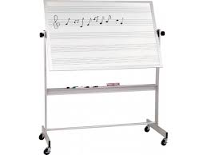
Classroom Environment
“Attempting to use fear as both a motivator and discipline tool during my early career created more problems for me than it solved.” (Jim Fay)
Procedures and rules will be clearly displayed
The band room is open for practicing during off hours

Slide 5
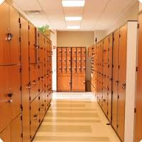
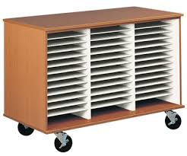
Procedures: Starting Class
“The effective teacher knows that student achievement will only occur when the students’ work environment is organized and structured.” (Wong)
Each students’ music will be in a folder which
will be organized on a rack in the room
All instruments will be kept in lockers
Students will be given five minutes at the start of class to
collect their instruments and folders and get to their seats

Slide 6
Procedures: Rehearsal
Any disruptions to another child’s learning will be faced with consequences
Consequences include loss in daily points
Treat all school property with respect and care
Listen to what other sections are being instructed because it may apply to you
Pencils are required for writing directions in the music
“Positive Behavioral Supports for Young Children: Set aside individual time, tell children about the good things they do, allow children to have limited choices.” (Thomas J. Zirpoli)

Slide 7
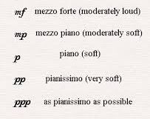
Procedures: End of Class
Students will receive five minutes at the end of class to put away their instrument and music
All students must stay in the classroom until the bell rings
Students can speak with each other at no louder than a mezzo piano volume

Slide 8
Classroom Situations
Disruption during rehearsal
Not meeting the standards of organization
Not following start and end of class procedures
Talk to student after class alone
Explain why you are speaking to them clearly
Discuss fair consequences
If behavior doesn’t change call a conference with parents

Slide 9
Challenges Faced in The Classroom
Working with students of different skills levels
Continuously finding challenges for over-achieving students
Being aware of our budget while improving the program
Working with the schedules of students in extracurricular activities

Slide 10
References
Fay, Jim. Creating a Love and Logic School Culture. Golden, CO: Love and Logic Institute, 2011. Print.
Marzano, R.J., Marzano, J.S. & Pickering, D. J. (2003). Classroom Management That Works: Research-based Strategies for Every Teacher. : Alexandria, VA: Association for Supervision and Curriculum Development.
Zirpoli, T. J. (2014). Behavior Management: Positive Applications for Teachers (6 ed.). New York, NY: Pearson.
Wong, H. K., Wong, R. T., Jondahl, S. F., & Ferguson, O. F. (2014). The Classroom Management Book.
Mountain View: Harry K. Wong Publications, Inc

